Slide 1
ASP.Net Core –Handling requests with the middleware pipeline
Kamal Beydoun
Lebanese University – Faculty of Sciences I
Kamal.beydoun@ul.edu.lb
Notes:
TIP You can view the application code for this chapter in the GitHub repository for the book at https://github.com/andrewlock/asp-dot-net-core-in-action. Once you’ve created your application, I’ll show you how to restore all the necessary dependencies, compile your application, and run it to see the HTML output. The application will be simple in some respects—it will only have three different pages—but it’ll be a fully configured ASP.NET Core application.

Slide 2
Middleware pipeline
The middleware pipeline is one of the most important parts of configuration for defining how your application behaves and how it responds to requests.
Understanding how to build and compose middleware is key to adding functionality to your applications.
Notes:
In this chapter, you’ll learn what middleware is and how to use it to create a pipeline. You’ll see how you can chain multiple middleware components together, with each component adding a discrete piece of functionality

Slide 3
What is middleware?
In ASP.NET Core, middleware is C# classes that can handle an HTTP request or response.
Middleware can:
Handle an incoming HTTP request by generating an HTTP response.
Process an incoming HTTP request, modify it, and pass it on to another piece of middleware.
Process an outgoing HTTP response, modify it, and pass it on to either another piece of middleware, or the ASP.NET Core web server.
Notes:
For example, a piece of logging middleware might note when a request arrived and then pass it on to another piece of middleware. Meanwhile, an image-resizing middleware component might spot an incoming request for an image with a specified size, generate the requested image, and send it back to the user without passing it on.

Slide 4
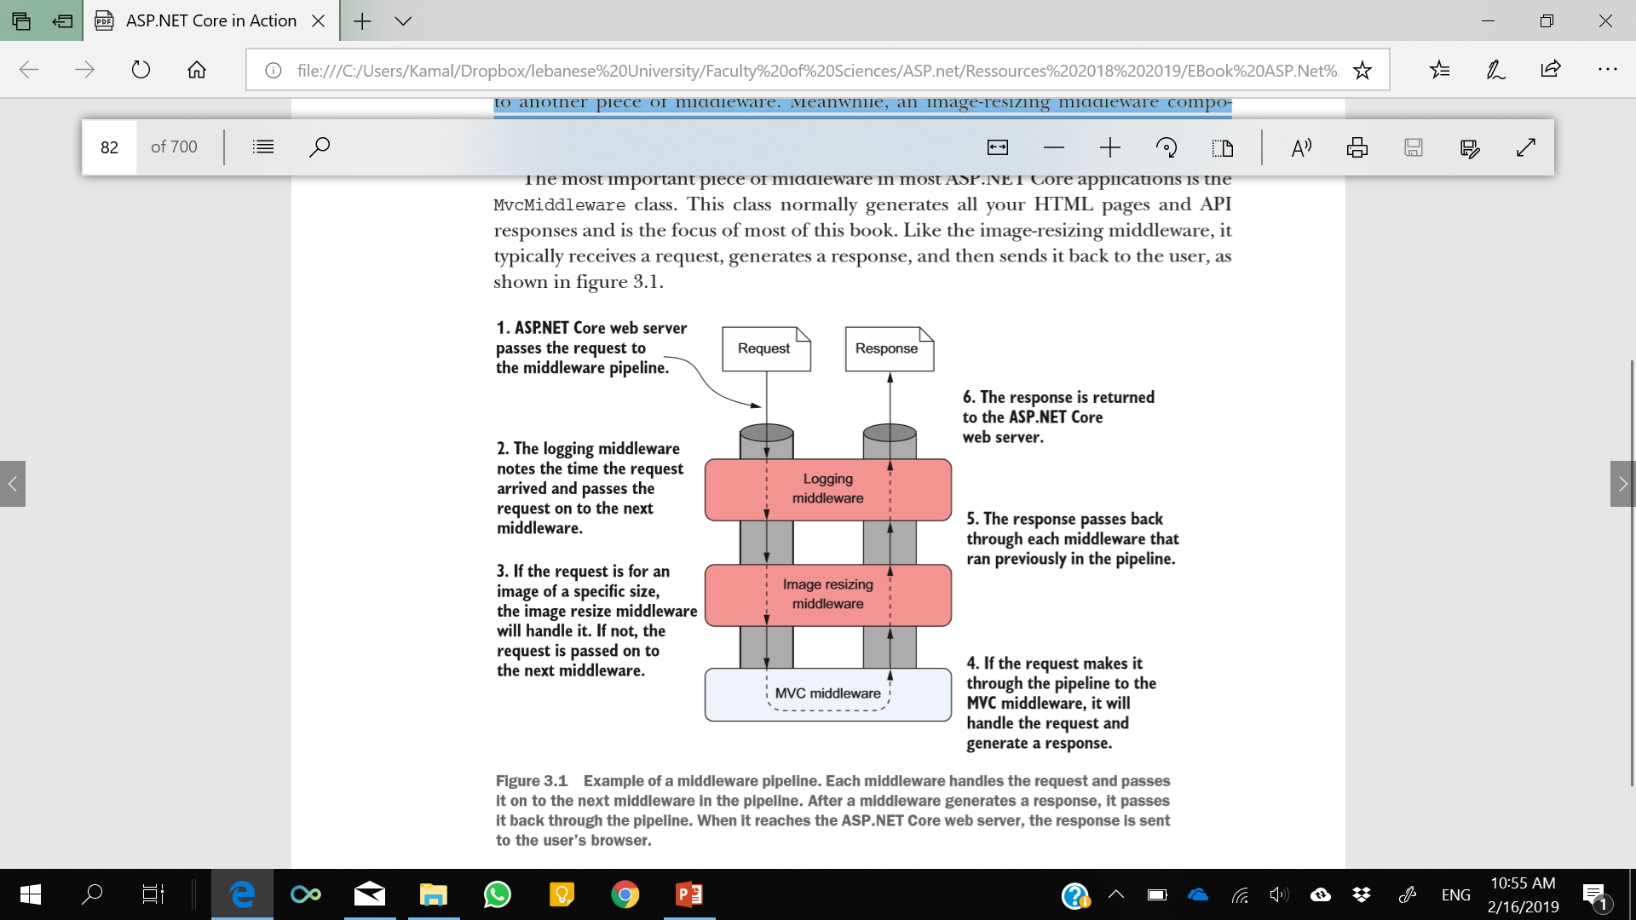
Pipeline
This arrangement, where a piece of middleware can call another piece of middleware, which in turn can call another, and so on, is referred to as a pipeline.

Slide 5
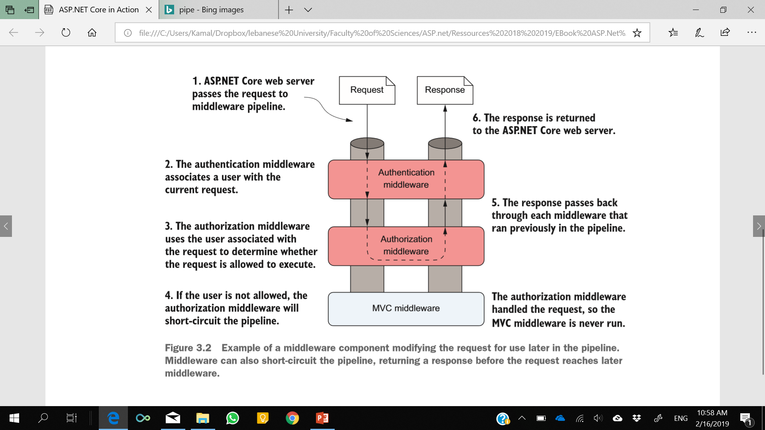
Example
A key point to glean from this is that the pipeline is bidirectional.
Notes:
Example of a middleware component modifying the request for use later in the pipeline. Middleware can also short-circuit the pipeline, returning a response before the request reaches later middleware.

Slide 6
HttpContext object
The ASP.NET Core web server constructs an HttpContext, which the ASP.NET Core application uses as a sort of storage box for a single request.
details of the original HTTP request and other configuration details
All middleware has access to the HttpContext for a request.
Notes:
All middleware has access to the HttpContext for a request. It can use this, for example, to determine whether the request contained any user credentials, which page the request was attempting to access, and to fetch any posted data. It can then use these details to determine how to handle the request.
Once the application has finished processing the request, it will update the HttpContext with an appropriate response and return it through the middleware pipeline to the web server. The ASP.NET Core web server will then convert the representation into a raw HTTP response and send it back to the reverse proxy, which will forward it to the user’s browser.

Slide 7
Combining middleware in a pipeline
How to create a middleware pipeline by composing small components together ??
Using standard middleware components
create a holding page
serve static files from a folder on disk.
Notes:
In the rest of this section, you’ll see how to create a middleware pipeline by composing small components together. Using standard middleware components, you’ll learn to create a holding page and to serve static files from a folder on disk.

Slide 8
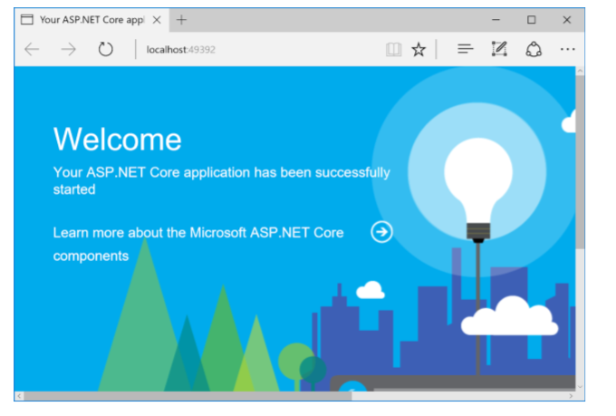
WelcomePageMiddleware
WelcomePageMiddleware is designed to quickly provide a sample page when you’re first developing an application.
WelcomePageMiddleware is contained in the Microsoft.AspNetCore.Diagnostics NuGet package, which most new project templates include by default as part of the Microsoft.AspNetCore.All metapackage.
Notes:
In this section, you’ll see how to create one of the simplest middleware pipelines, consisting of WelcomePageMiddleware only.

Slide 9
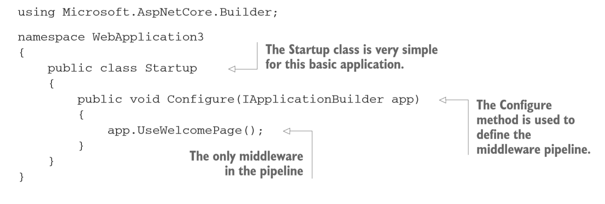
Startup.cs
Configure method of Startup by adding middleware to an IApplicationBuilder object.
Notes:
As you can see, the Startup for this application is very simple. The application has no configuration and no services, so Startup doesn’t have a constructor or a ConfigureServices method. The only required method is Configure, in which you call UseWelcomePage.
You build the middleware pipeline in ASP.NET Core by calling methods on IApplicationBuilder, but this interface doesn’t define methods like UseWelcomePage itself. Instead, these are extension methods, defined in each middleware’s NuGet package. Using extension methods allows these packages to effectively add functionality to the IApplicationBuilder class, while keeping their functionality isolated from it.
Under the hood, the methods are typically calling another extension method to add the middleware to the pipeline. For example, behind the scenes, the UseWelcomePage method adds the WelcomePageMiddleware to the pipeline using UseMiddleware<WelcomePageMiddleware>();
This convention of creating an extension method for each piece of middleware and starting the method name with Use is designed to improve discoverability when adding middleware to your application. You still have to remember to reference the appropriate NuGet package in your csproj project file before the extension methods will become available!
Calling the UseWelcomePage method adds WelcomePageMiddleware as the next middleware in the pipeline. Although you’re only using a single middleware component here, it’s important to remember that the order in which you make calls to IApplicationBuilder in Configure defines the order that the middleware will run in the pipeline.

Slide 10
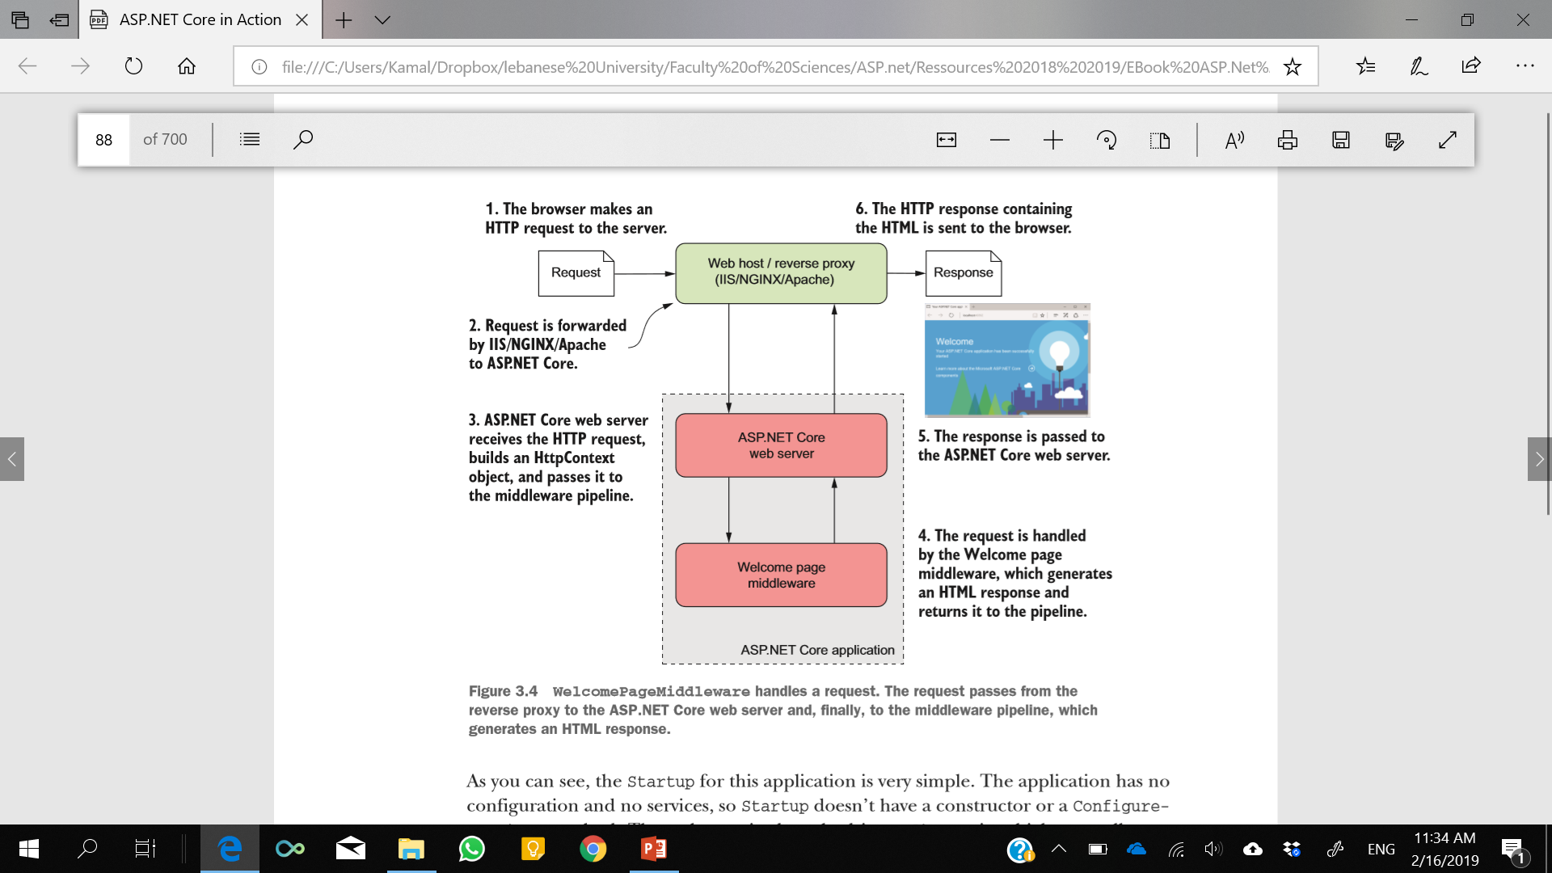

Slide 11
Handling static files
Most web applications, including those with dynamic content, serve a number of pages using static files.
Images, JavaScript, and CSS stylesheets are normally saved to disk during development and are served up when requested, normally as part of a full HTML page request.

Slide 12
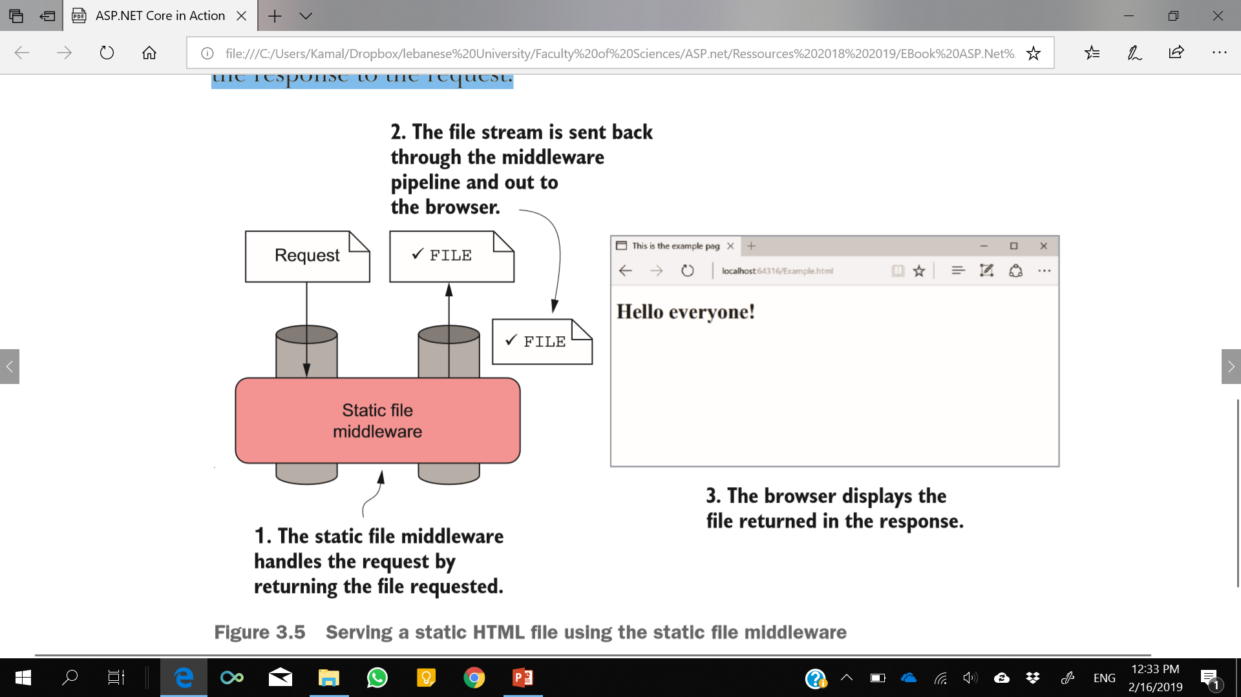
Notes:
In this example, a static HTML file called Example.html exists in the wwwroot folder. When you request the file using the /Example.html path, it’s loaded and returned as the response to the request.

Slide 13
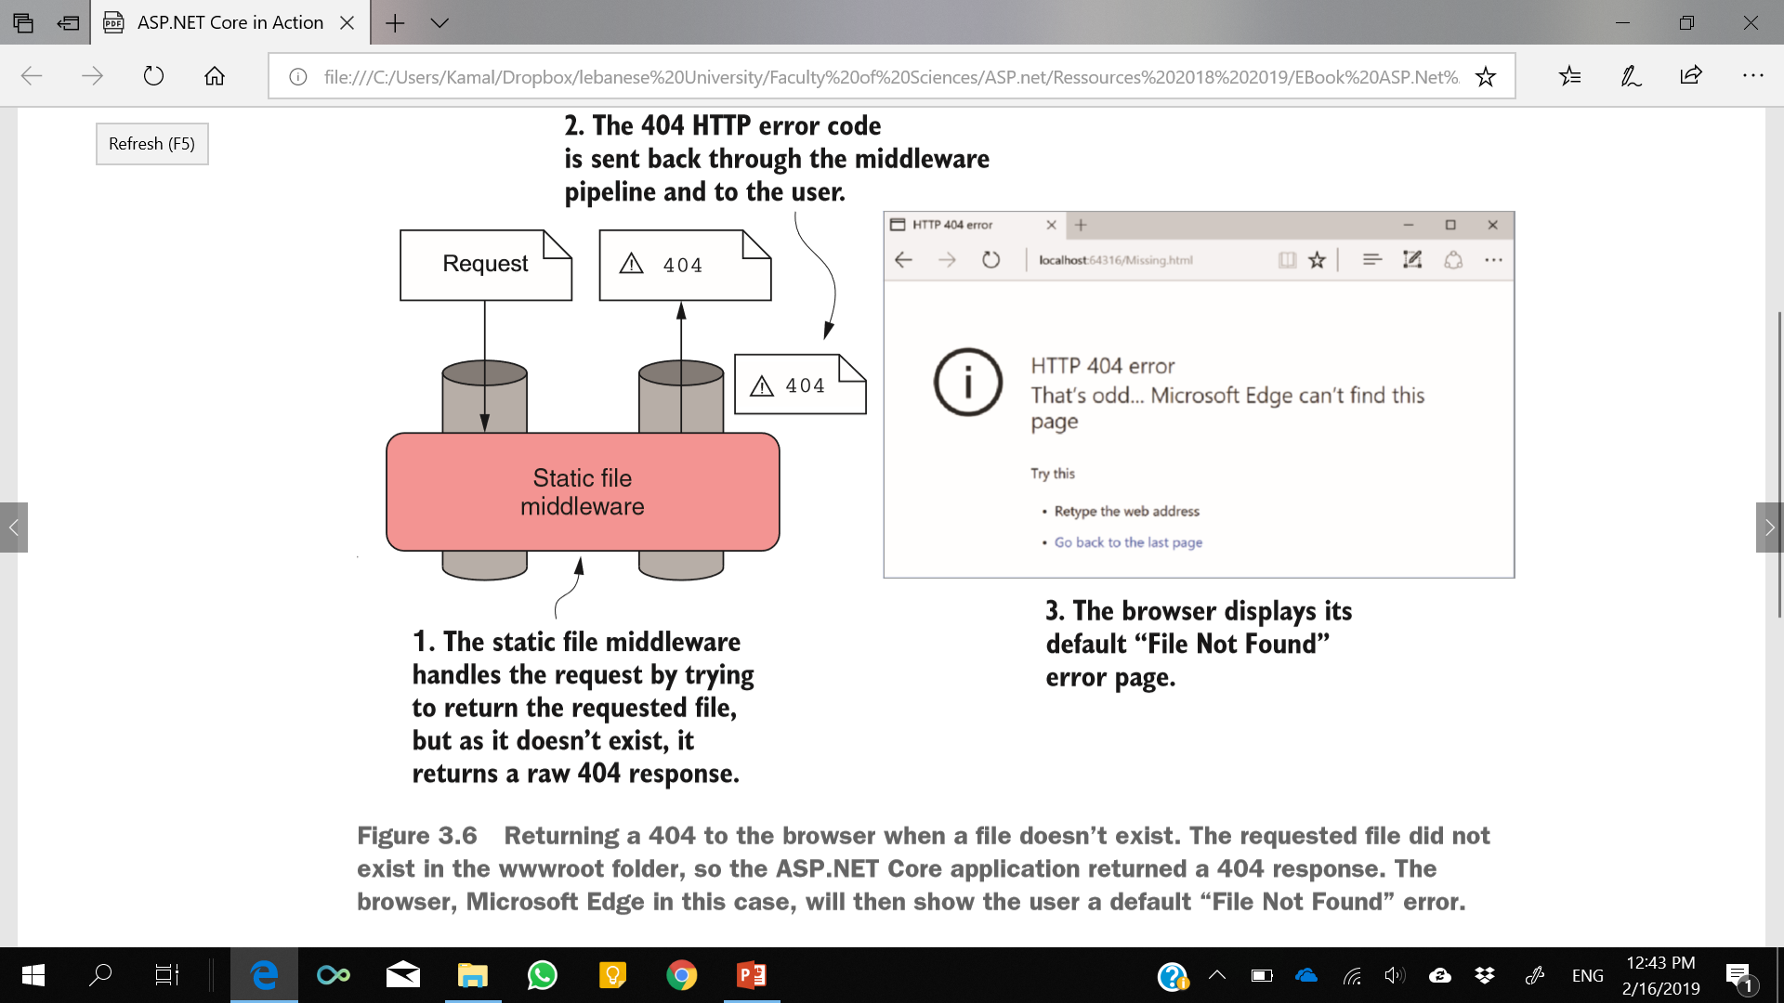
`
If the user requests a file that doesn’t exist in the wwwroot folder
a 404 HTTP error code response will be sent to the user’s browser, which will show its default “File Not Found” page
Notes:
If the user requests a file that doesn’t exist in the wwwroot folder, for example Missing.html, then the static file middleware won’t serve a file. Instead, a 404 HTTP error code response will be sent to the user’s browser, which will show its default “File Not Found” page

Slide 14
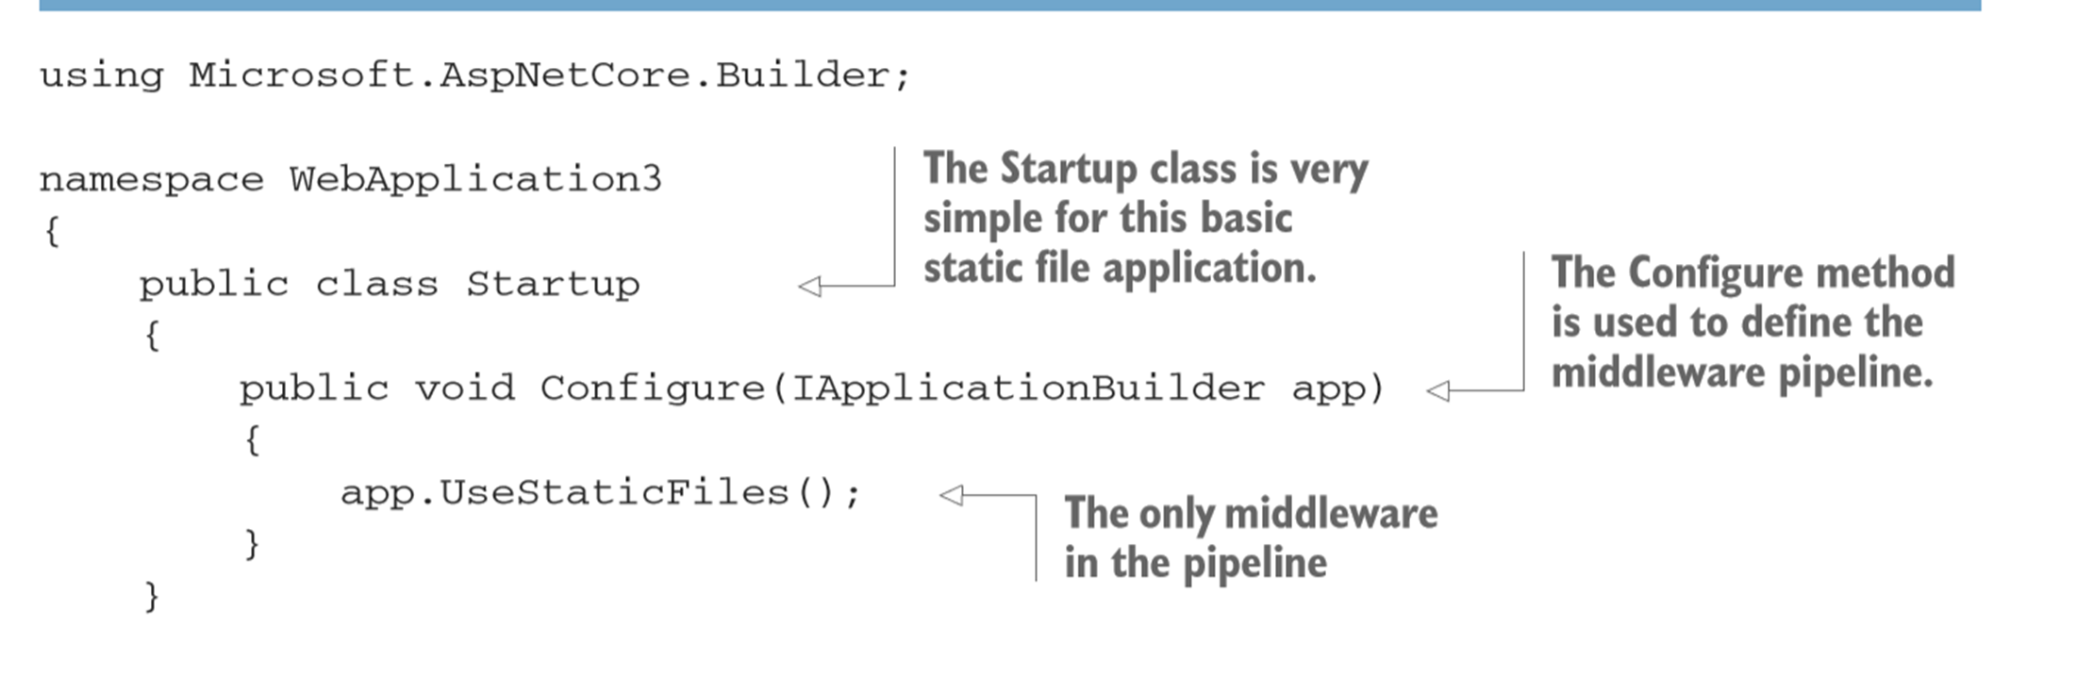

Slide 15
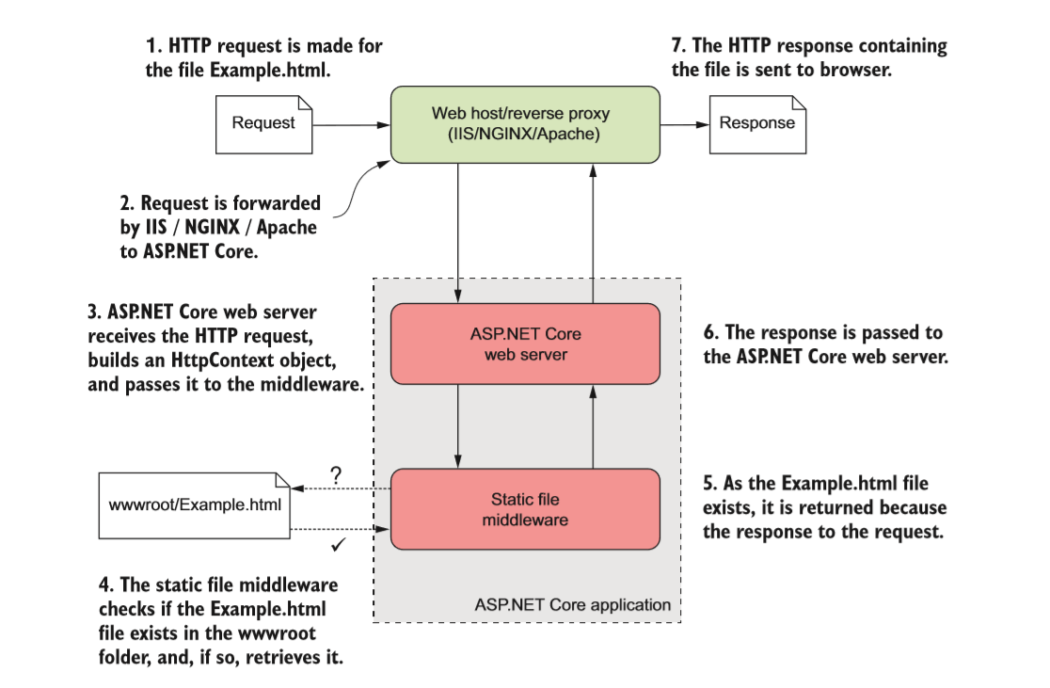
If the file doesn’t exist, then the request effectively passes through the static file middleware unchanged.
ASP.NET Core effectively adds an automatic “dummy” piece of middleware to the end of the pipeline.
This middleware always returns a 404 response if it’s called.
Notes:
If the file doesn’t exist, then the request effectively passes through the static file middleware unchanged. But wait, you only added one piece of middleware, right? Surely you can’t pass the request through to the next middleware if there isn’t another one? Luckily, ASP.NET Core effectively adds an automatic “dummy” piece of middleware to the end of the pipeline. This middleware always returns a 404 response if it’s called.

Slide 16
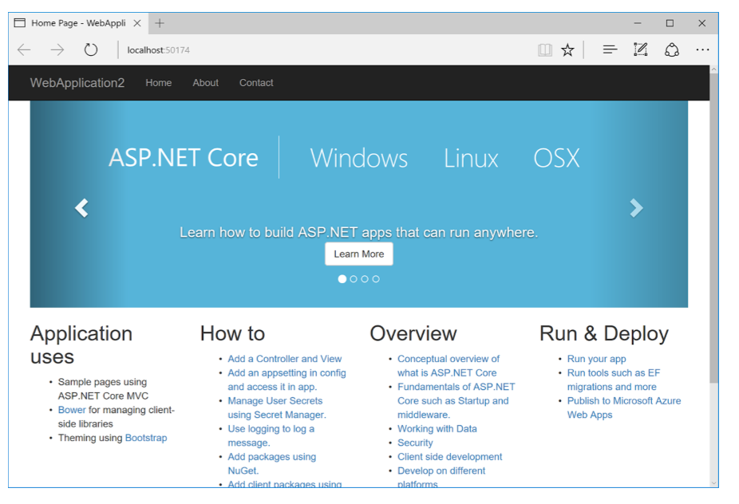
A MVC web application
Notes:
A simple MVC application. The application uses only three pieces of middleware: an MVC middleware to serve the HTML, a static file middleware to serve the image files, and an exception handler middleware to capture any errors.

Slide 17
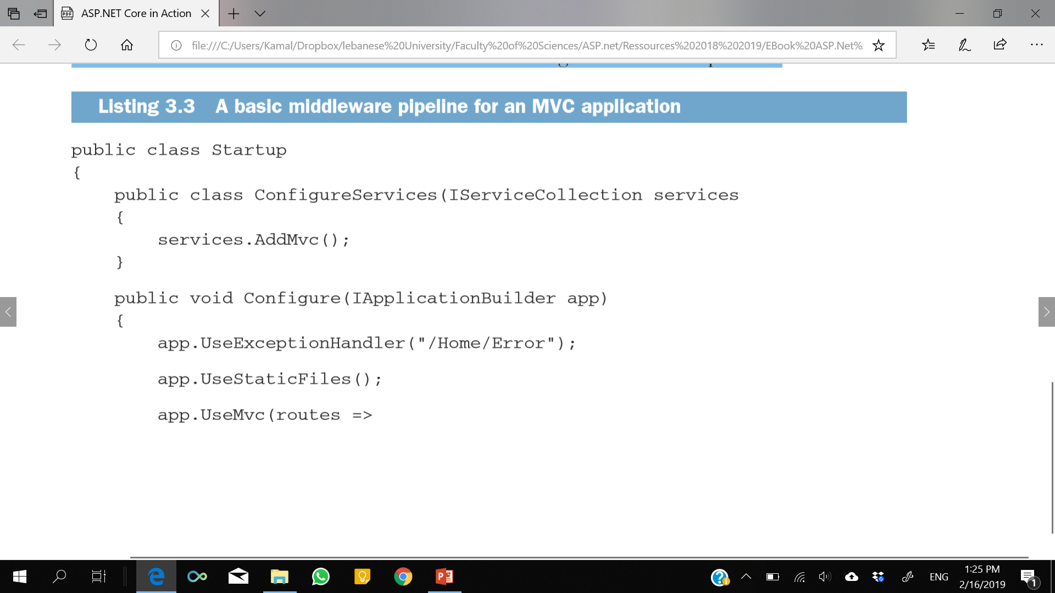
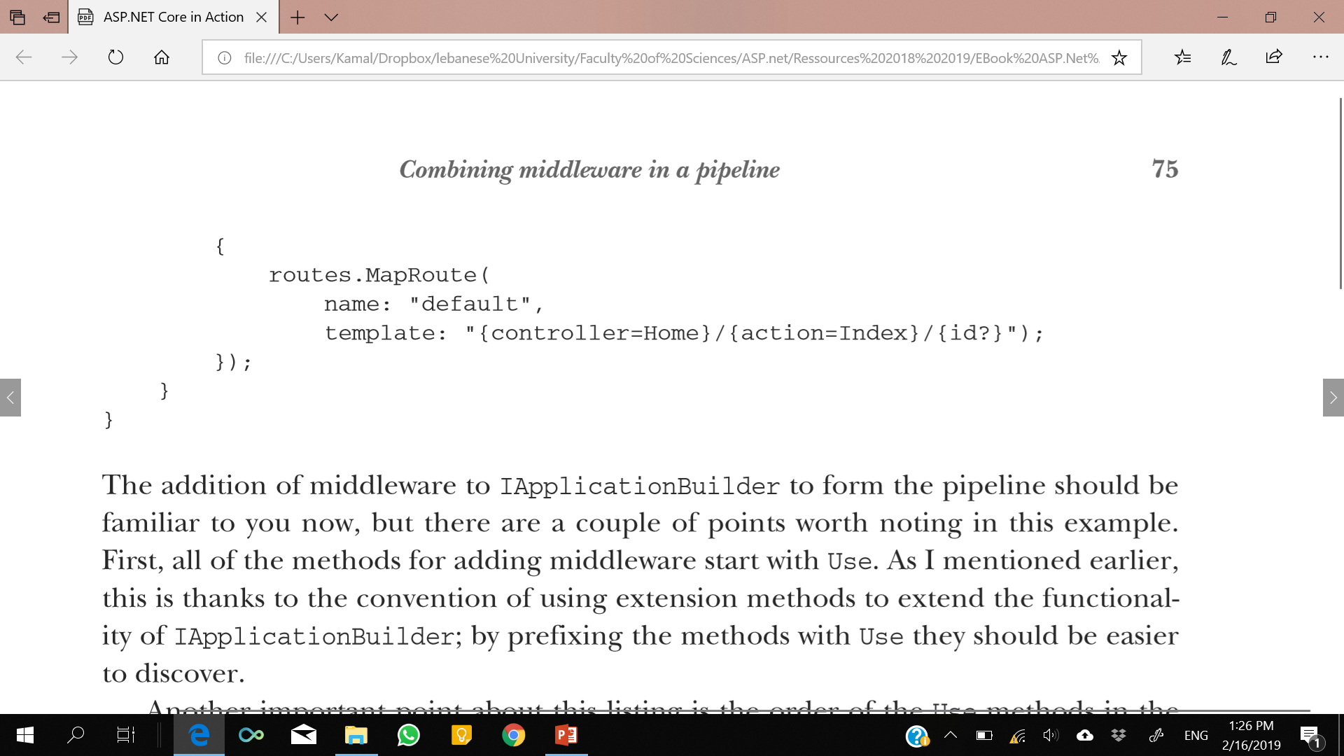
Notes:
As well as the middleware configuration, this also shows the call to AddMvc() in ConfigureServices, which is required when using MVC middleware. You’ll learn more about service configuration in chapter 10.
all of the methods for adding middleware start with Use.

Slide 18
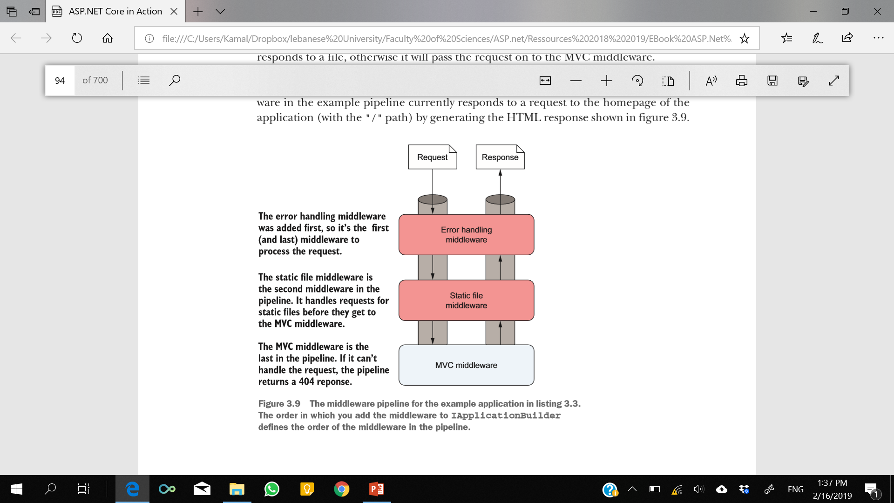
Notes:
the MVC middleware in the example pipeline currently responds to a request to the homepage of the application (with the "/" path) by generating the HTML response shown in figure.
In the previous example, I included ExceptionHandlerMiddleware at the start of the application’s middleware pipeline, but it didn’t seem to do anything. Error handling middleware characteristically ignores the incoming request as it arrives in the pipeline, and instead inspects the outgoing response, only modifying it when an error has occurred. In the next section, I’ll detail the types of error handling middleware that are available to use with your application and when to use them.

Slide 19
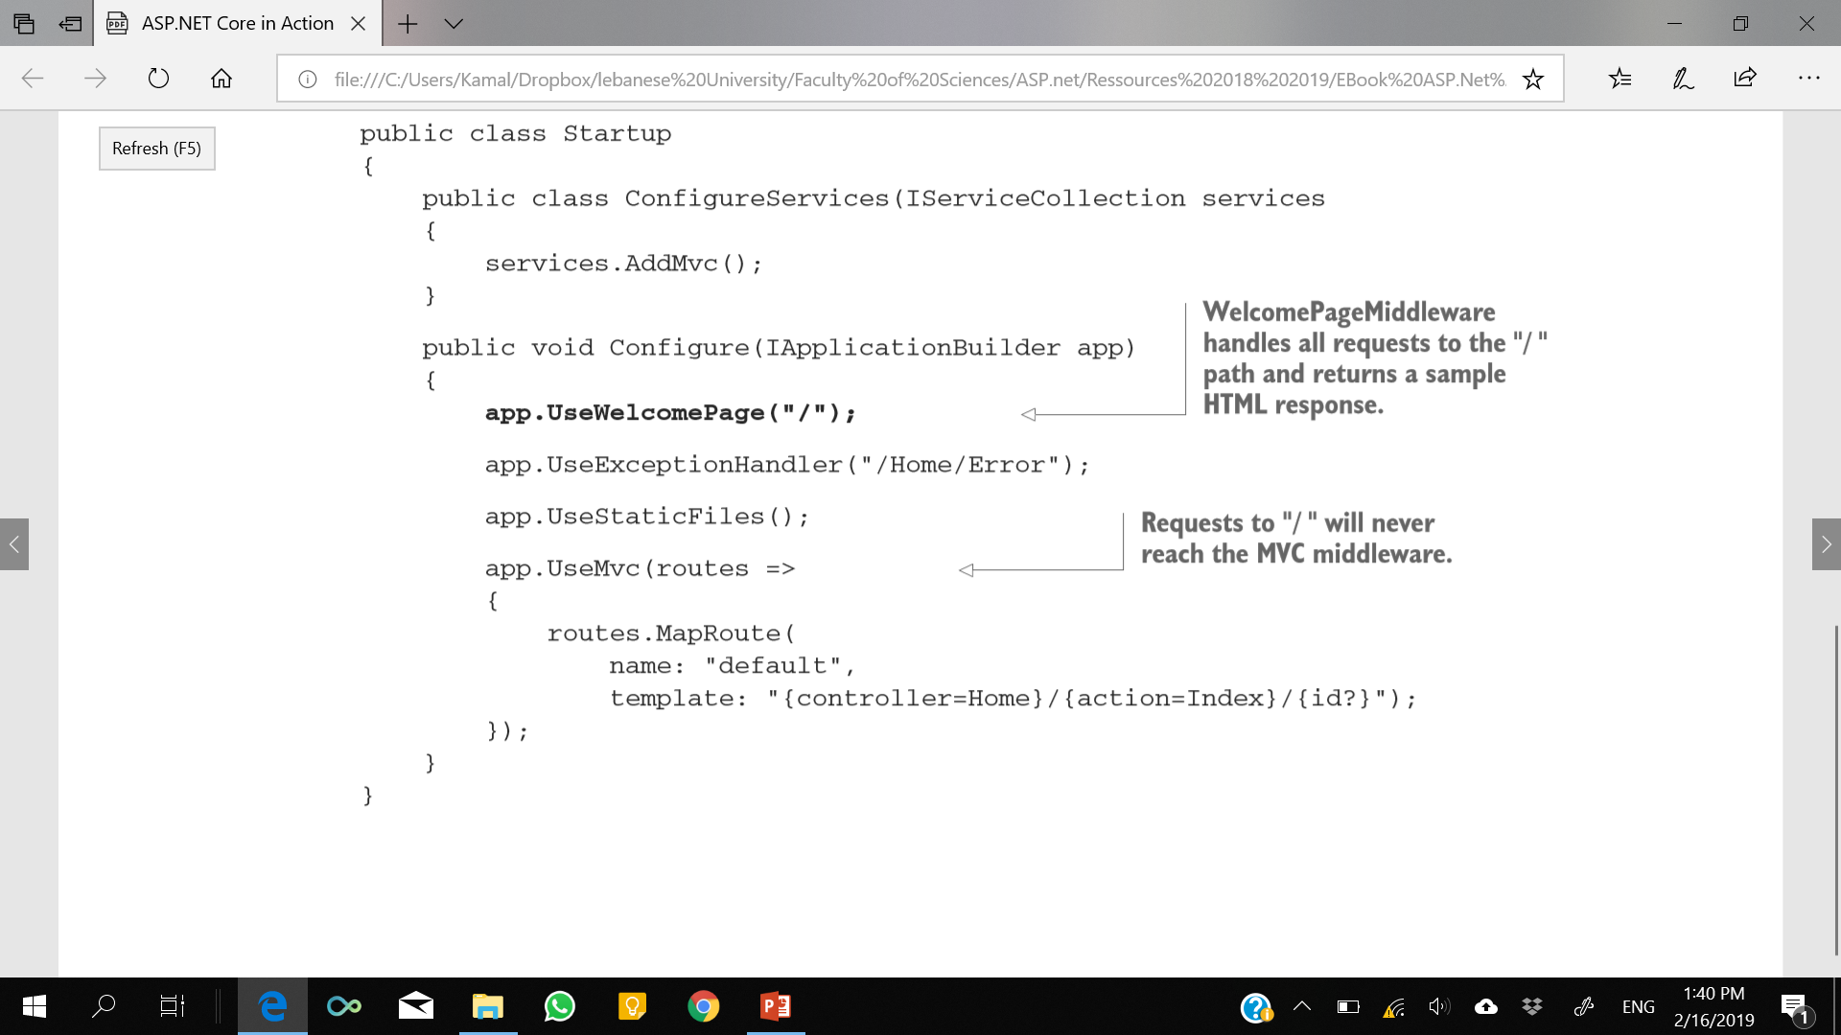
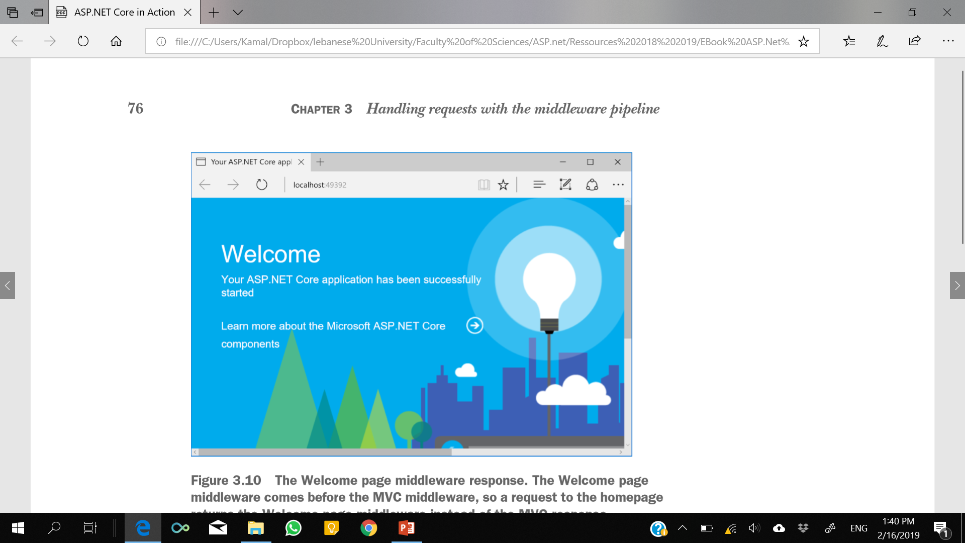
Notes:
Figure 3.10 shows what happens if you reintroduce a piece of middleware you saw previously, WelcomePageMiddleware, and configure it to respond to the "/" path as well. As you saw in section 3.2.1, WelcomePageMiddleware is designed to return a fixed HTML response, so you wouldn’t use it in a production app, but it illustrates the point nicely. In the following listing, it’s added to the start of the middleware pipeline and configured to respond only to the "/" path.

Slide 20
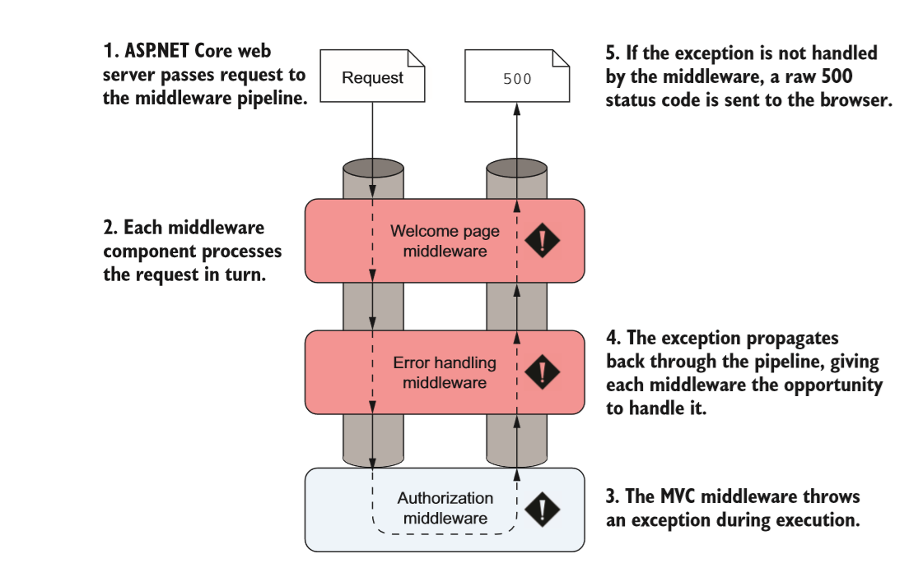
Handling errors using middleware
If an exception NullReferenceException occurs in a middleware component, it propagates up the pipeline.
If the pipeline doesn’t handle the exception, the web server will return a 500 status code back to the user.

Slide 21
Handling errors using middleware
Error handling middleware attempts to address these problems by modifying the response before the app returns it to the user.
returns details of the error that occurred
returns a generic, but friendly, HTML page to the user.
Place error handling middleware early in the middleware pipeline to ensure it will catch any errors generated in subsequent middleware
Notes:
The remainder of this section shows several types of error handling middleware that are available for use in your application. You can use any of them by referencing either the Microsoft.AspNetCore.All or the Microsoft.AspNetCore.Diagnostics NuGet packages in your project’s csproj file.

Slide 22
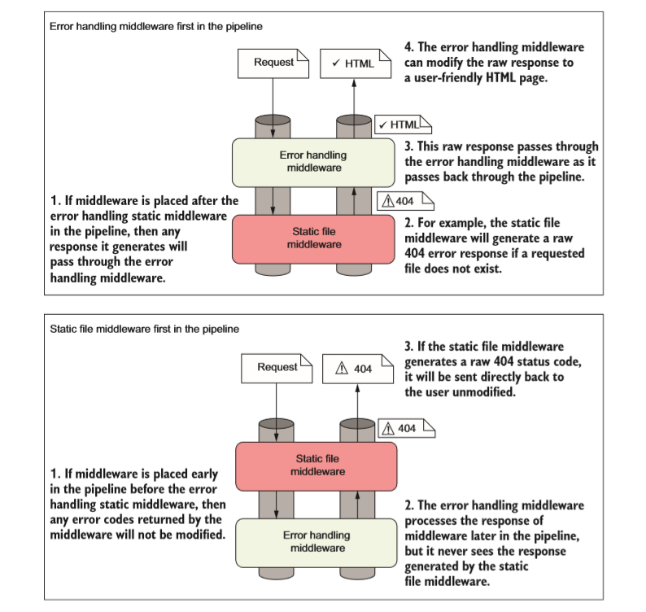
Handling errors using middleware

Slide 23
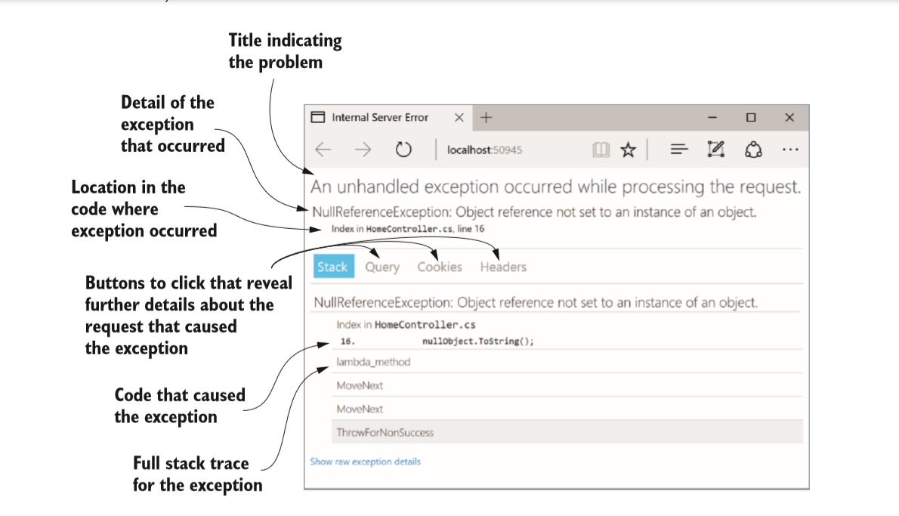
Viewing exceptions in development: DeveloperExceptionPage
Microsoft provides DeveloperExceptionPageMiddleware, which can be added to your middleware pipeline using app.UseDeveloperExceptionPage();
Notes:
You should never return more details about your application to users than absolutely necessary, so you should only ever use DeveloperExceptionPage when developing your application. The clue is in the name!

Slide 24
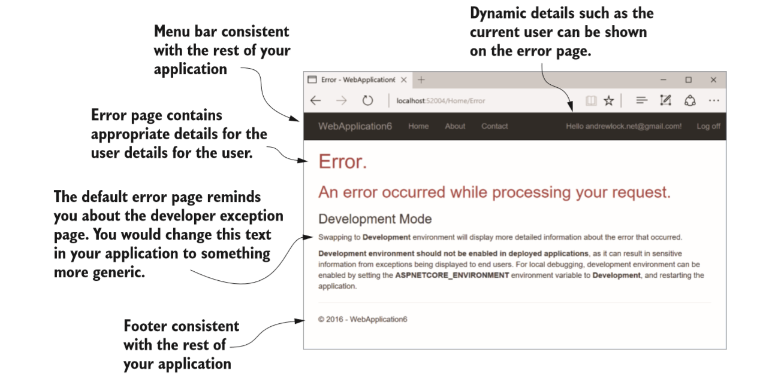
Handling exceptions in production: ExceptionHandlerMiddleware

Slide 25
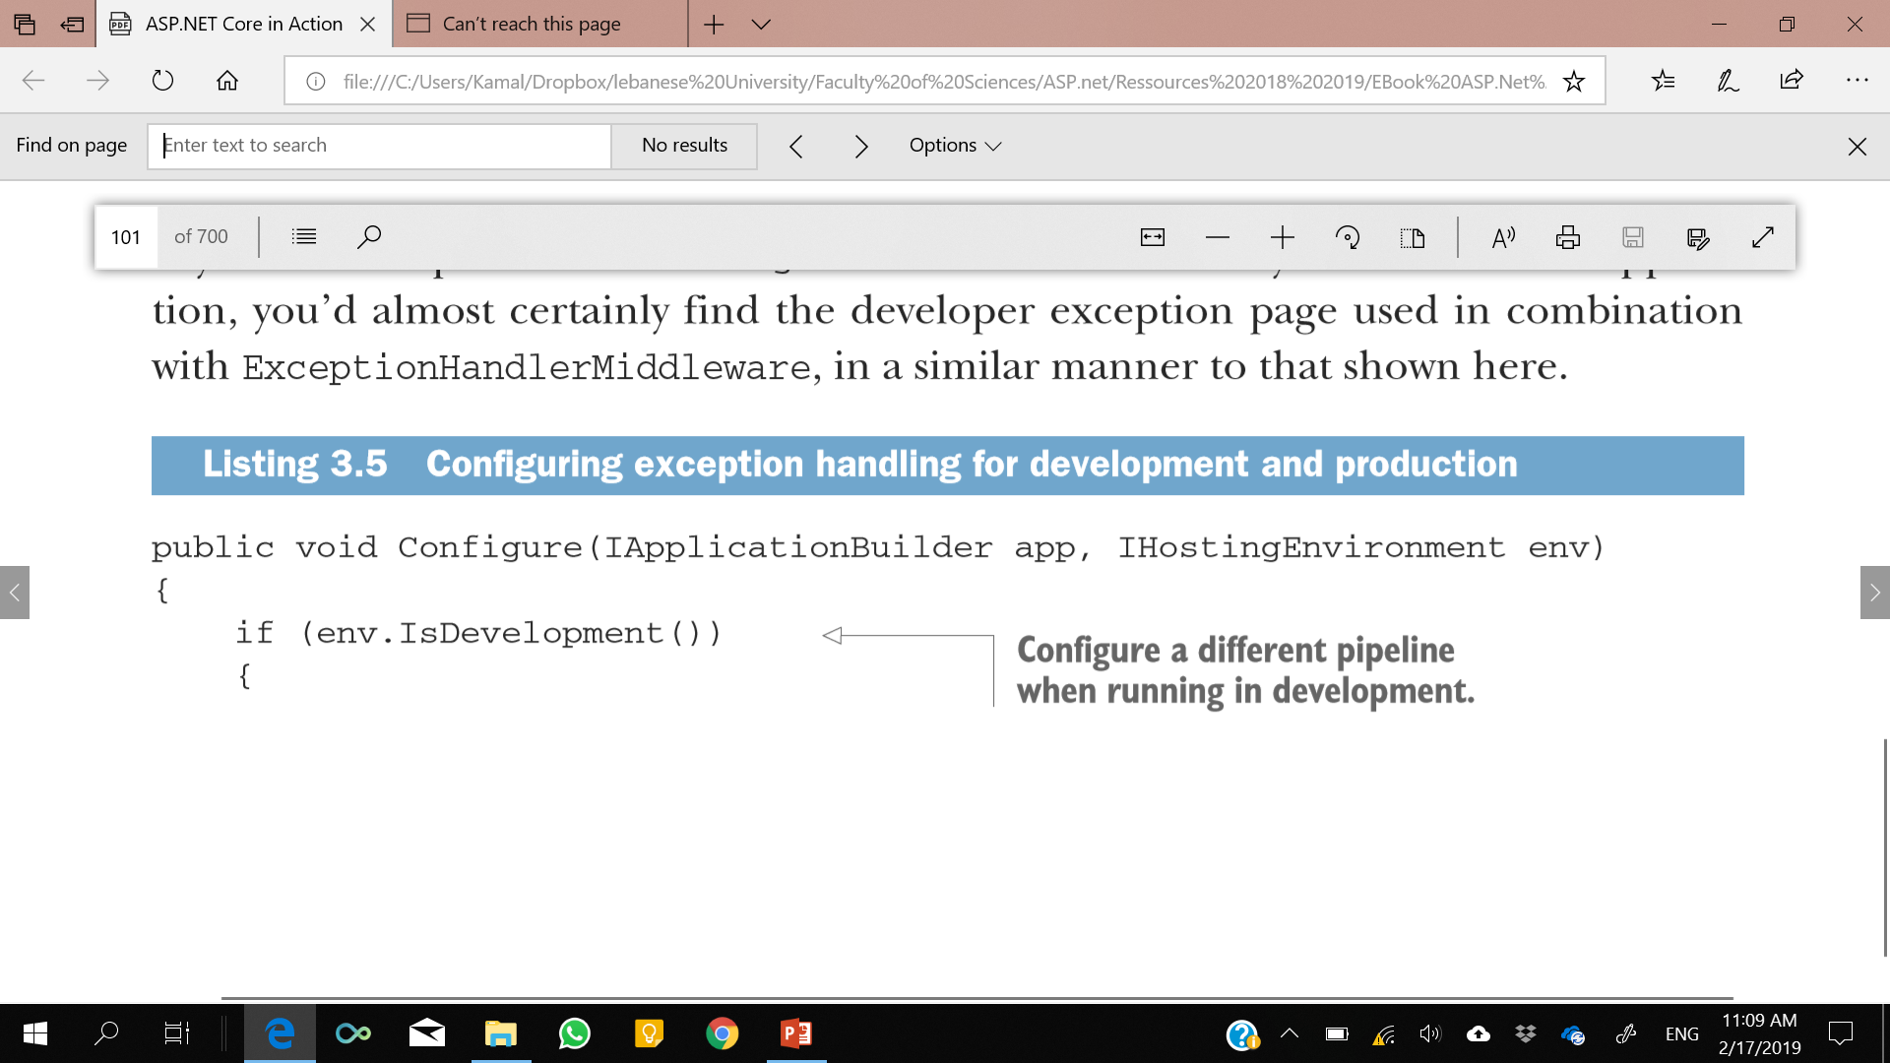
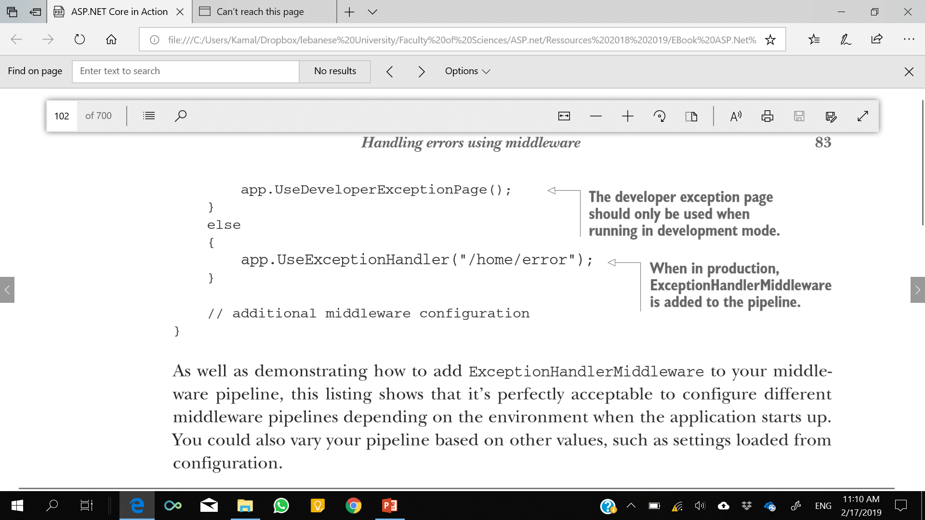
Handling exceptions
Notes:
You’ll see how to use configuration values to customize the middleware pipeline in chapter 11.

Slide 26
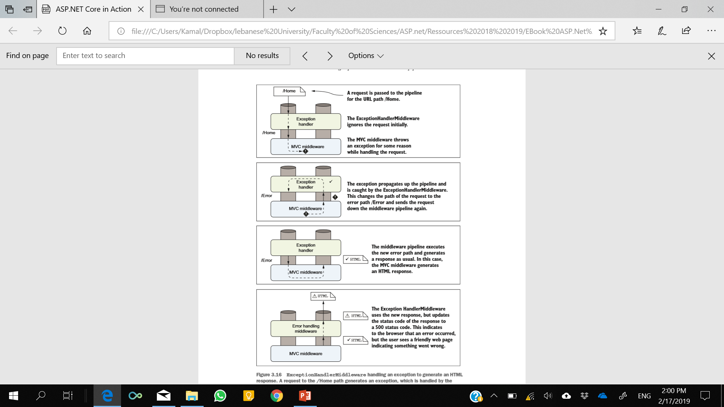
Notes:
Figure 3.16 shows what happens when ExceptionHandlerMiddleware handles an exception. It shows the flow of events when the MVC middleware generates an exception when a request is made to the /home path. The final response returns an error status code but also provides an HTML response to display to the user, using the /error path.
The sequence of events when an exception occurs somewhere in the middleware pipeline after ExceptionHandlerMiddleware is as follows: 1 A piece of middleware throws an exception. 2 ExceptionHandlerMiddleware catches the exception. 3 Any partial response that has been defined is cleared. 4 The middleware overwrites the request path with the provided error handling path. 5 The middleware sends the request back down the pipeline, as though the original request had been for the error handling path. 6 The middleware pipeline generates a new response as normal. 7 When the response gets back to ExceptionHandlerMiddleware, it modifies the status code to a 500 error and continues to pass the response up the pipeline to the web server.
WARNING If your error handling path generates an error, the user will see a generic browser error. It’s often better to use a static error page that will always work, rather than a dynamic page that risks throwing more errors.
Re-executing the middleware pipeline is a great way to keep consistency in your web application for error pages, but there are some gotchas to be aware of. First, middleware can only modify a response generated further down the pipeline if the response hasn’t yet been sent to the client. This can be a problem if, for example, an error occurs while ASP.NET Core is sending a static file to a client. In that case, where bytes have already begun to be sent to the client, the error handling middleware won’t be able to run, as it can’t reset the response. Generally speaking, there’s not a lot you can do about this issue, but it’s something to be aware of. A more common problem occurs when the error handling path throws an error during the re-execution of the pipeline

Slide 27
Summary
Middleware has a similar role to HTTP modules and handlers in ASP.NET but is more easily reasoned about.
Middleware is composed in a pipeline, with the output of one middleware passing to the input of the next.
The middleware pipeline is two-way: requests pass through each middleware on the way in and responses pass back through in the reverse order on the way out.
Middleware can short-circuit the pipeline by handling a request and returning a response, or it can pass the request on to the next middleware in the pipeline.
Middleware can modify a request by adding data to, or changing, the HttpContext object.
If an earlier middleware short-circuits the pipeline, not all middleware will execute for all requests.
If a request isn’t handled, the middleware pipeline will return a 404 status code.

Slide 28
Summary
The order in which middleware is added to IApplicationBuilder defines the order in which middleware will execute in the pipeline.
The middleware pipeline can be re-executed, as long as a response’s headers haven’t been sent.
When added to a middleware pipeline, StaticFileMiddleware will serve any requested files found in the wwwroot folder of your application.
DeveloperExceptionPageMiddleware provides a lot of information about errors when developing an application but should never be used in production.
ExceptionHandlerMiddleware lets you provide user-friendly custom error handling messages when an exception occurs in the pipeline.
StatusCodePagesMiddleware lets you provide user-friendly custom error handlidsng messages when the pipeline returns a raw error response status code.
StatusCodePagesMiddleware can be disabled by accessing the Features property on HttpContext.
Microsoft provides some common middleware and there are many third-party options available on NuGet and GitHub.

